Slide 1


Roger Springs Site Analysis
Jessica Sloan Dickson
12/12/2019
SDS328M - Woodward

Slide 2
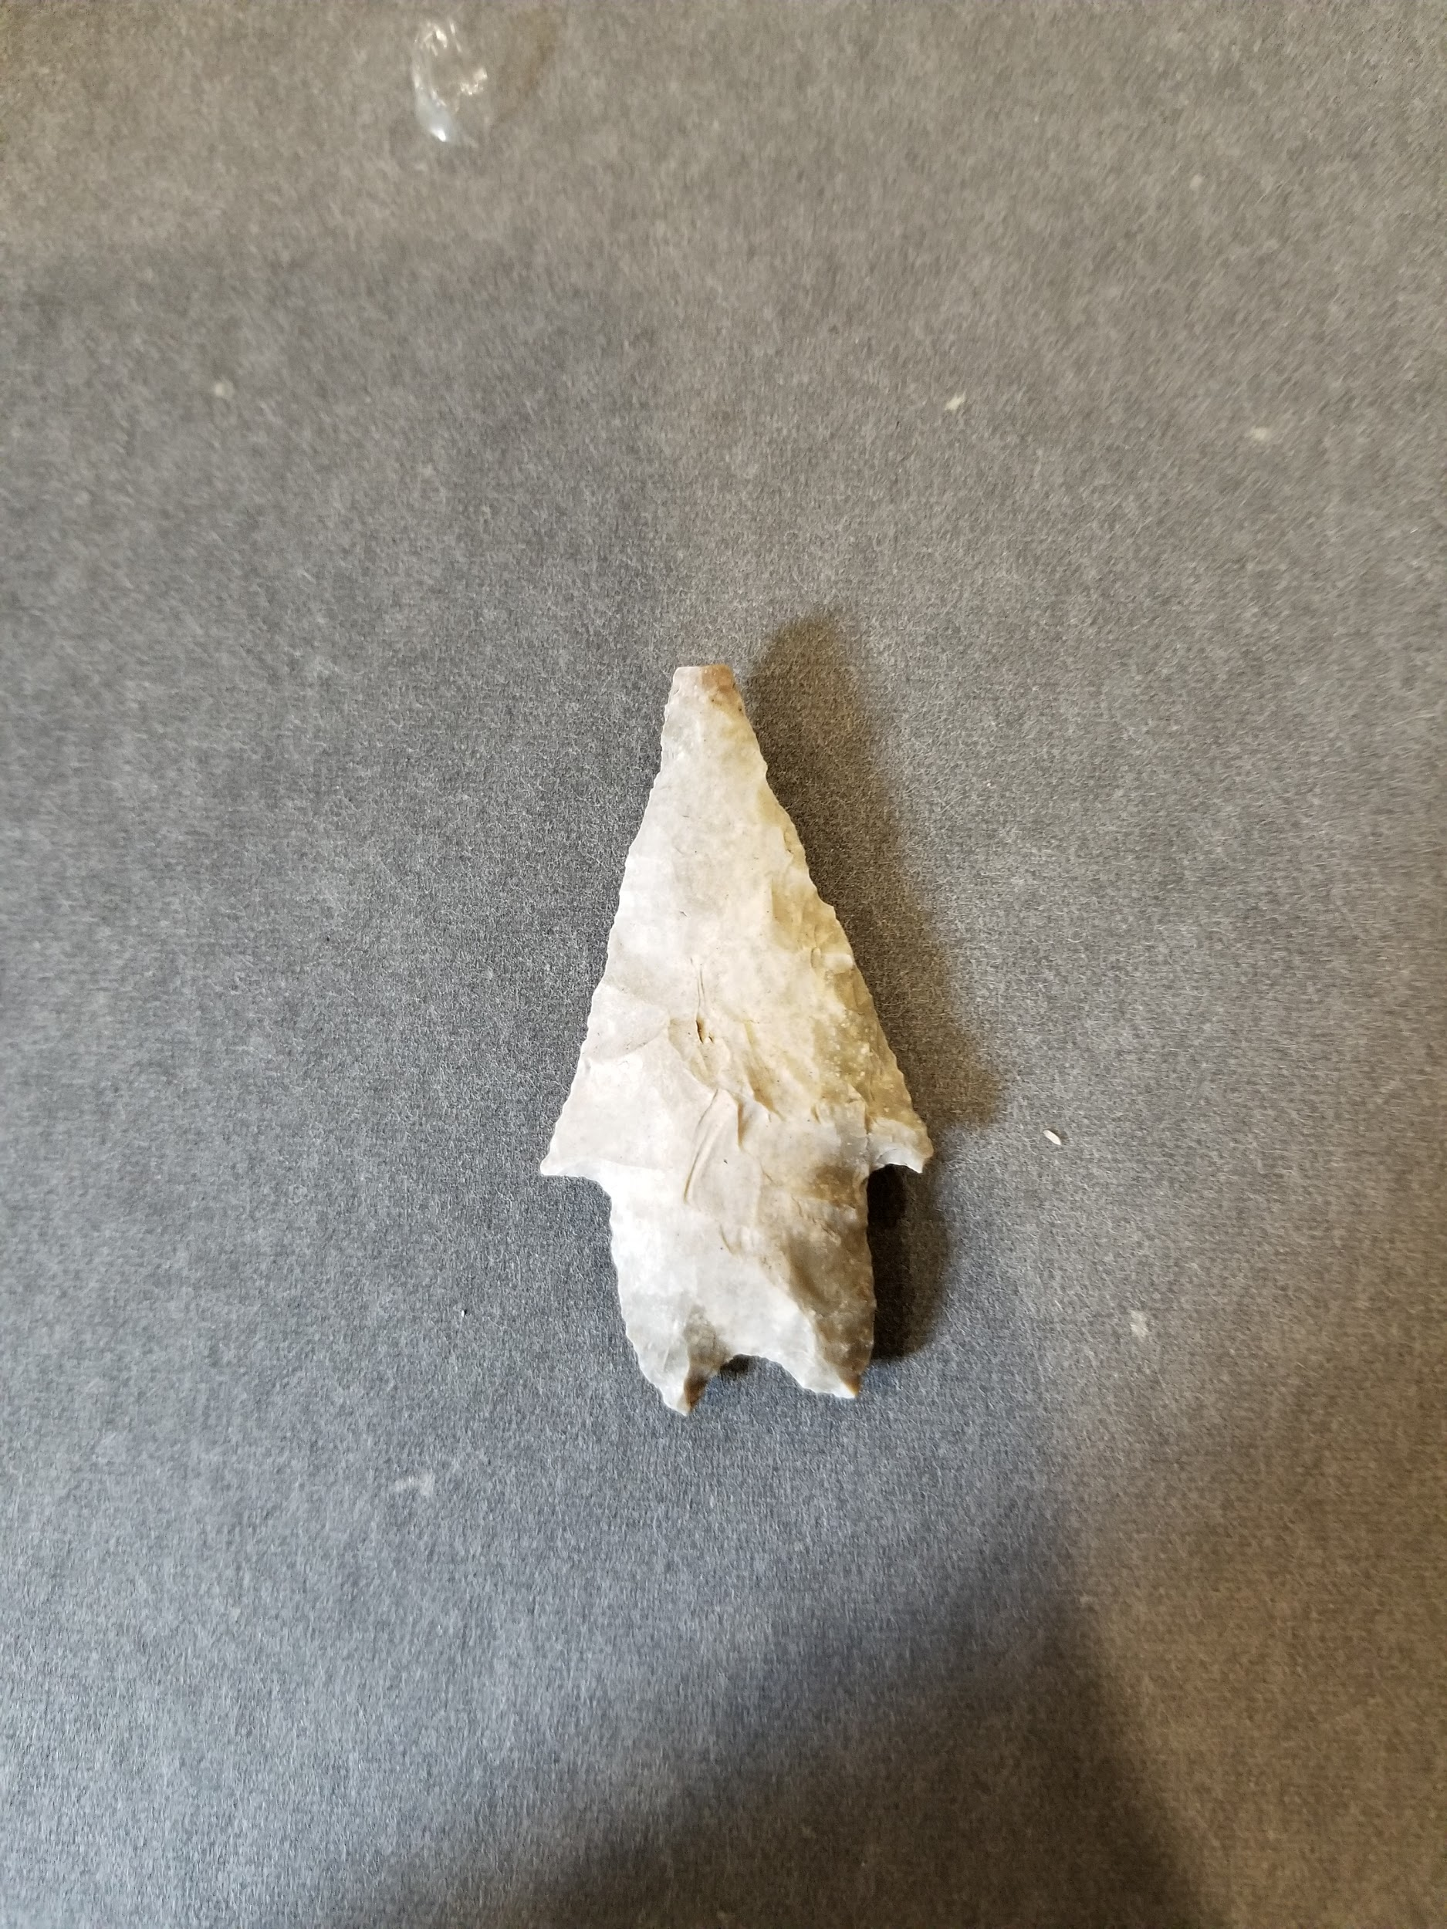
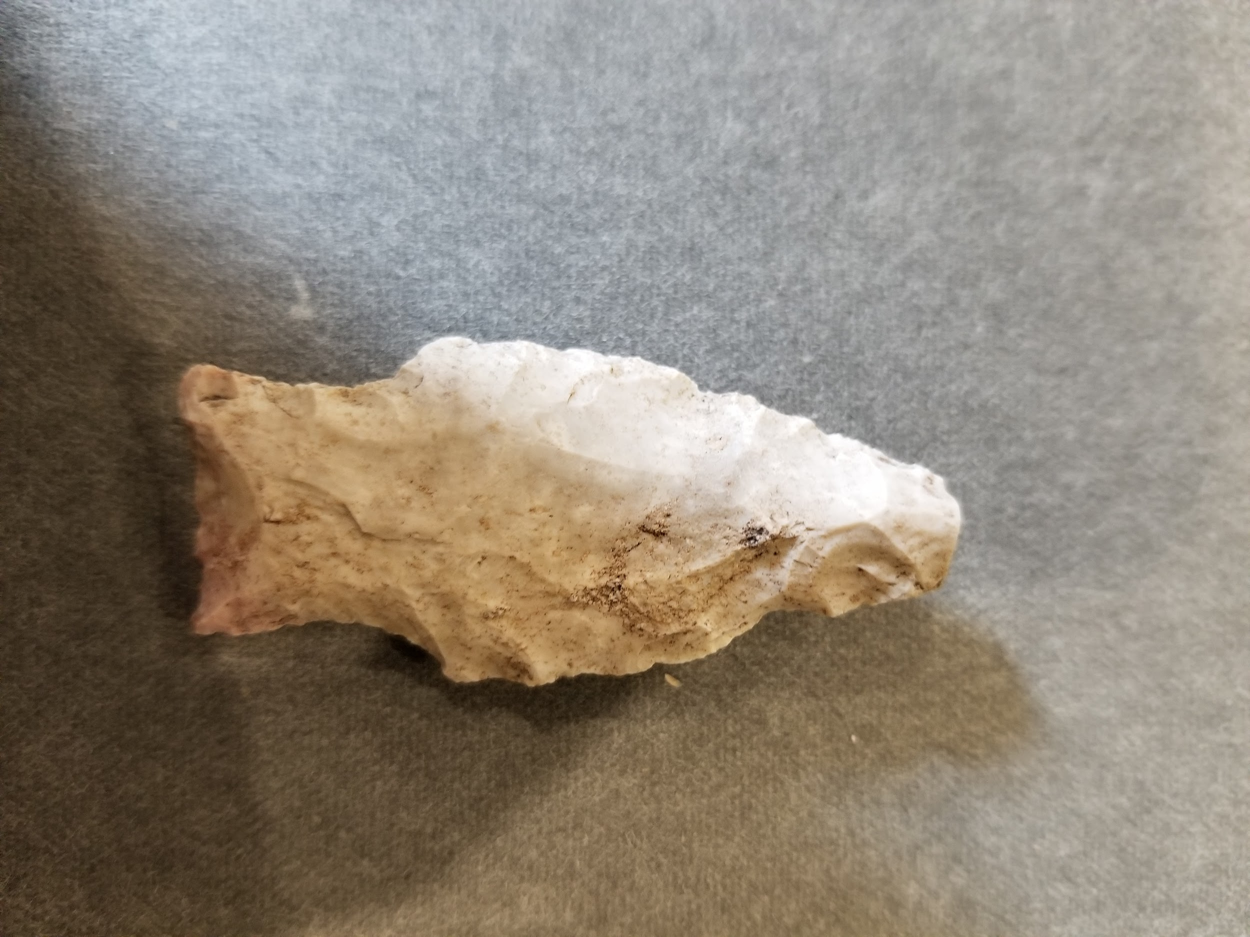
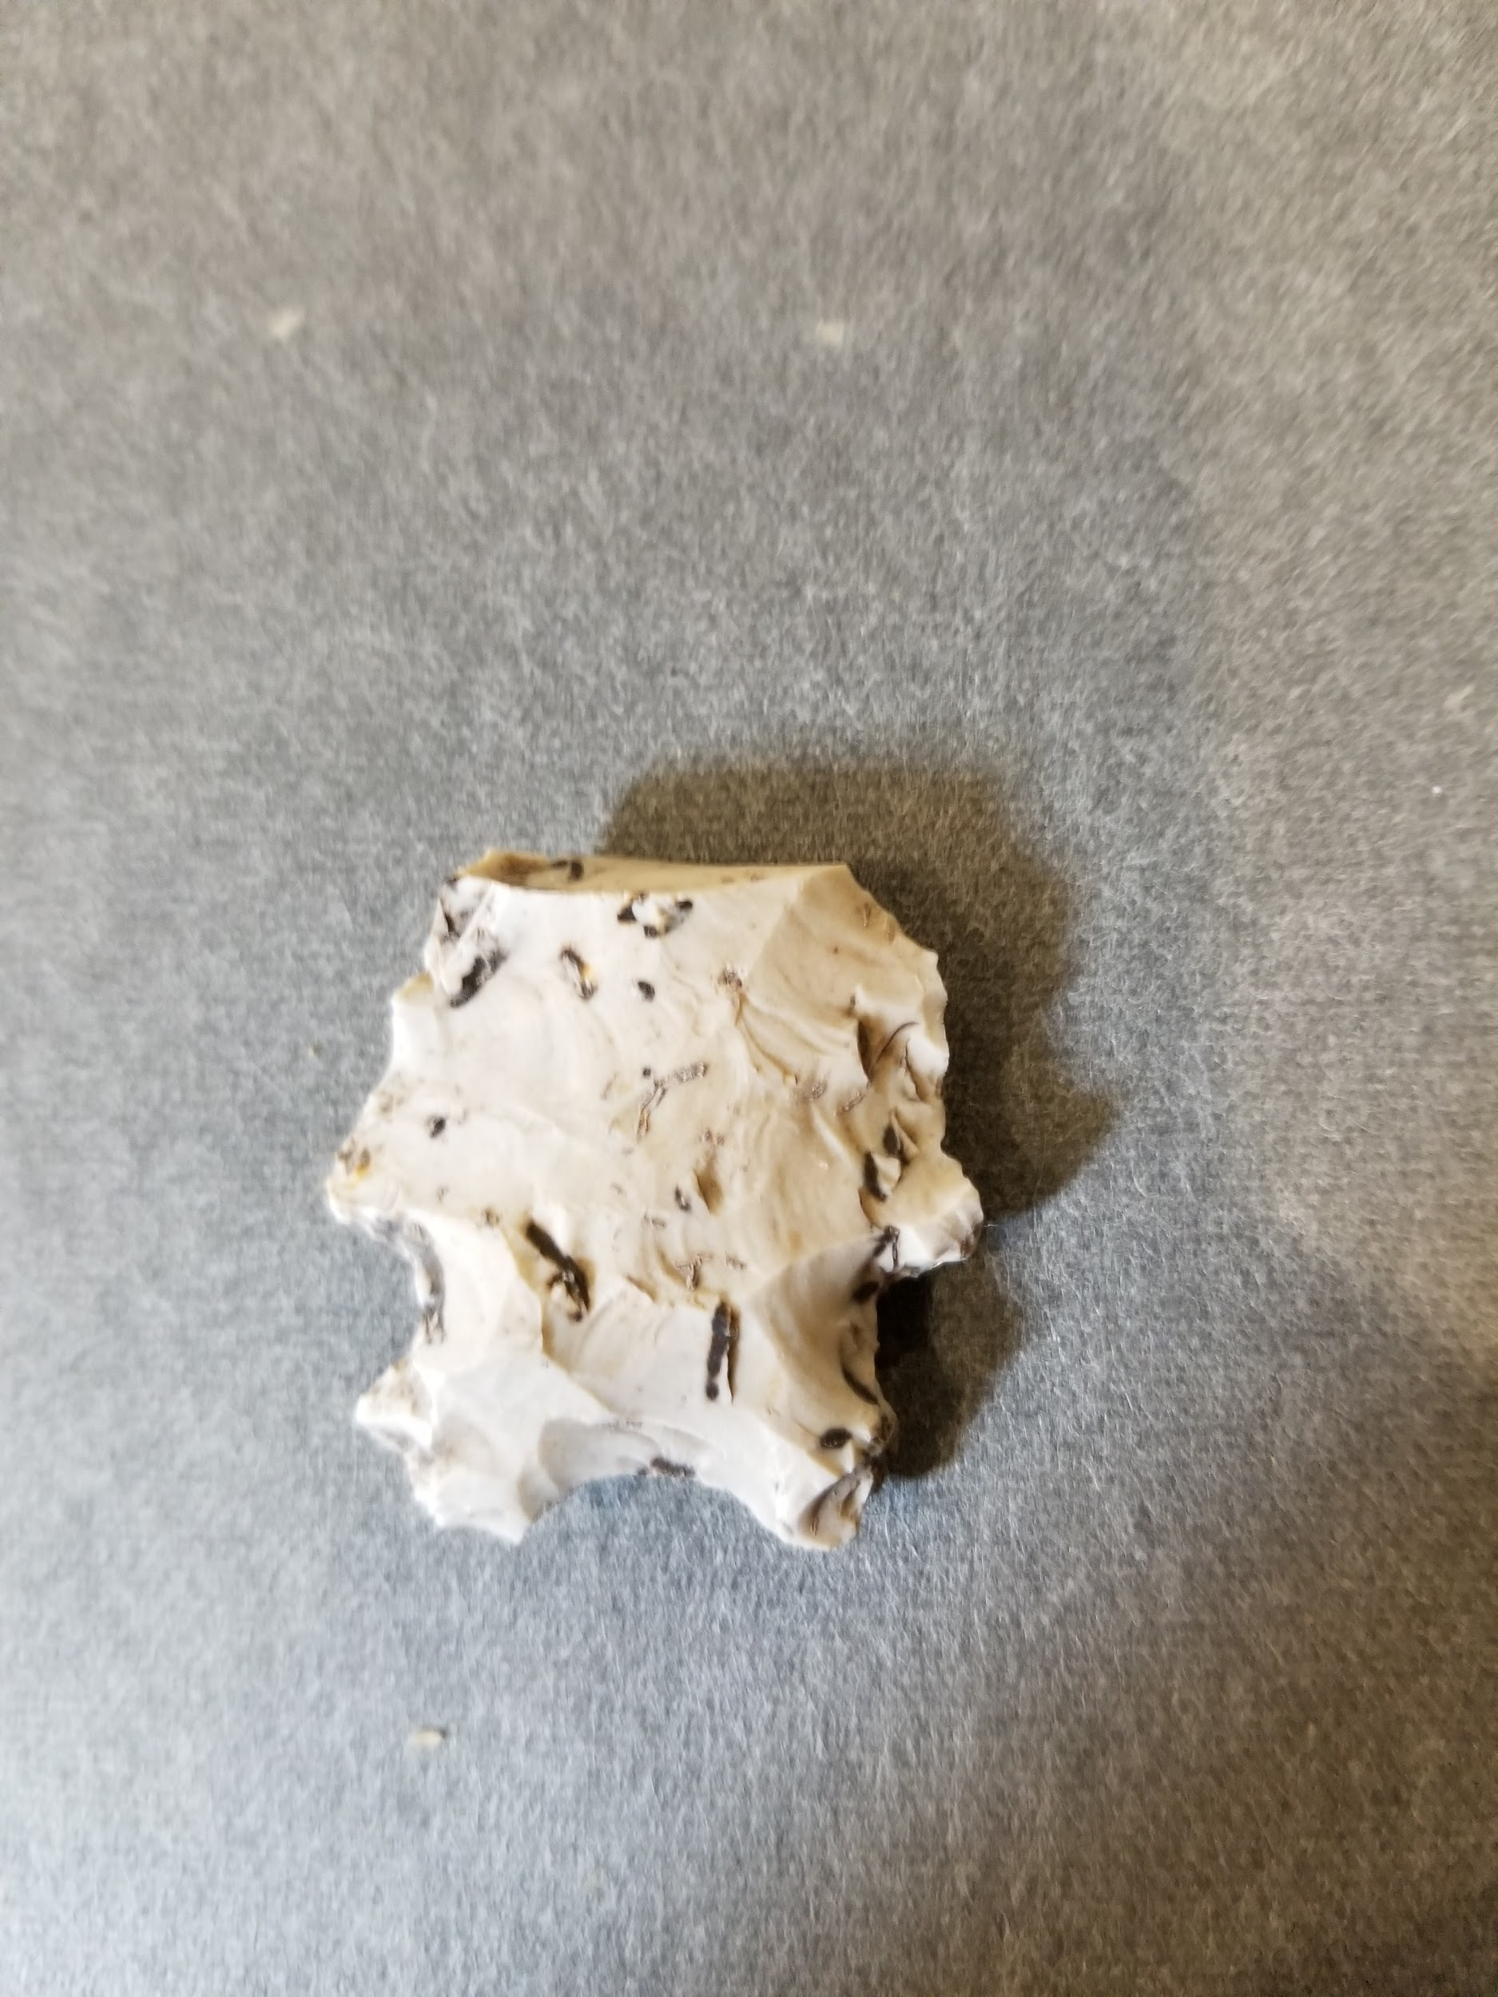
Introduction
Objectives:
This project hopes to examine the Roger Springs archaeological site and its stone tool assemblage. The intent is to understand the habitation and tool making patterns of this prehistoric site by looking into the stone tool counts, level (or depth) of excavation, and debitage counts. Can excavation level and debitage counts be predictors of stone tool counts?
Research Questions:
Are there certain excavation levels containing a larger amount of stone tools?
Is the number of pieces of debitage related to the number of stone tools found in a lot?
Pedernales Dart Point
Nolan Dart Point
Frio
Dart Point

Slide 3
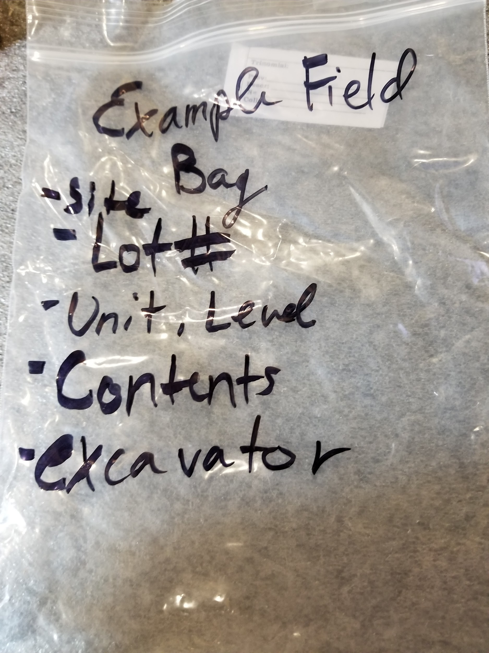
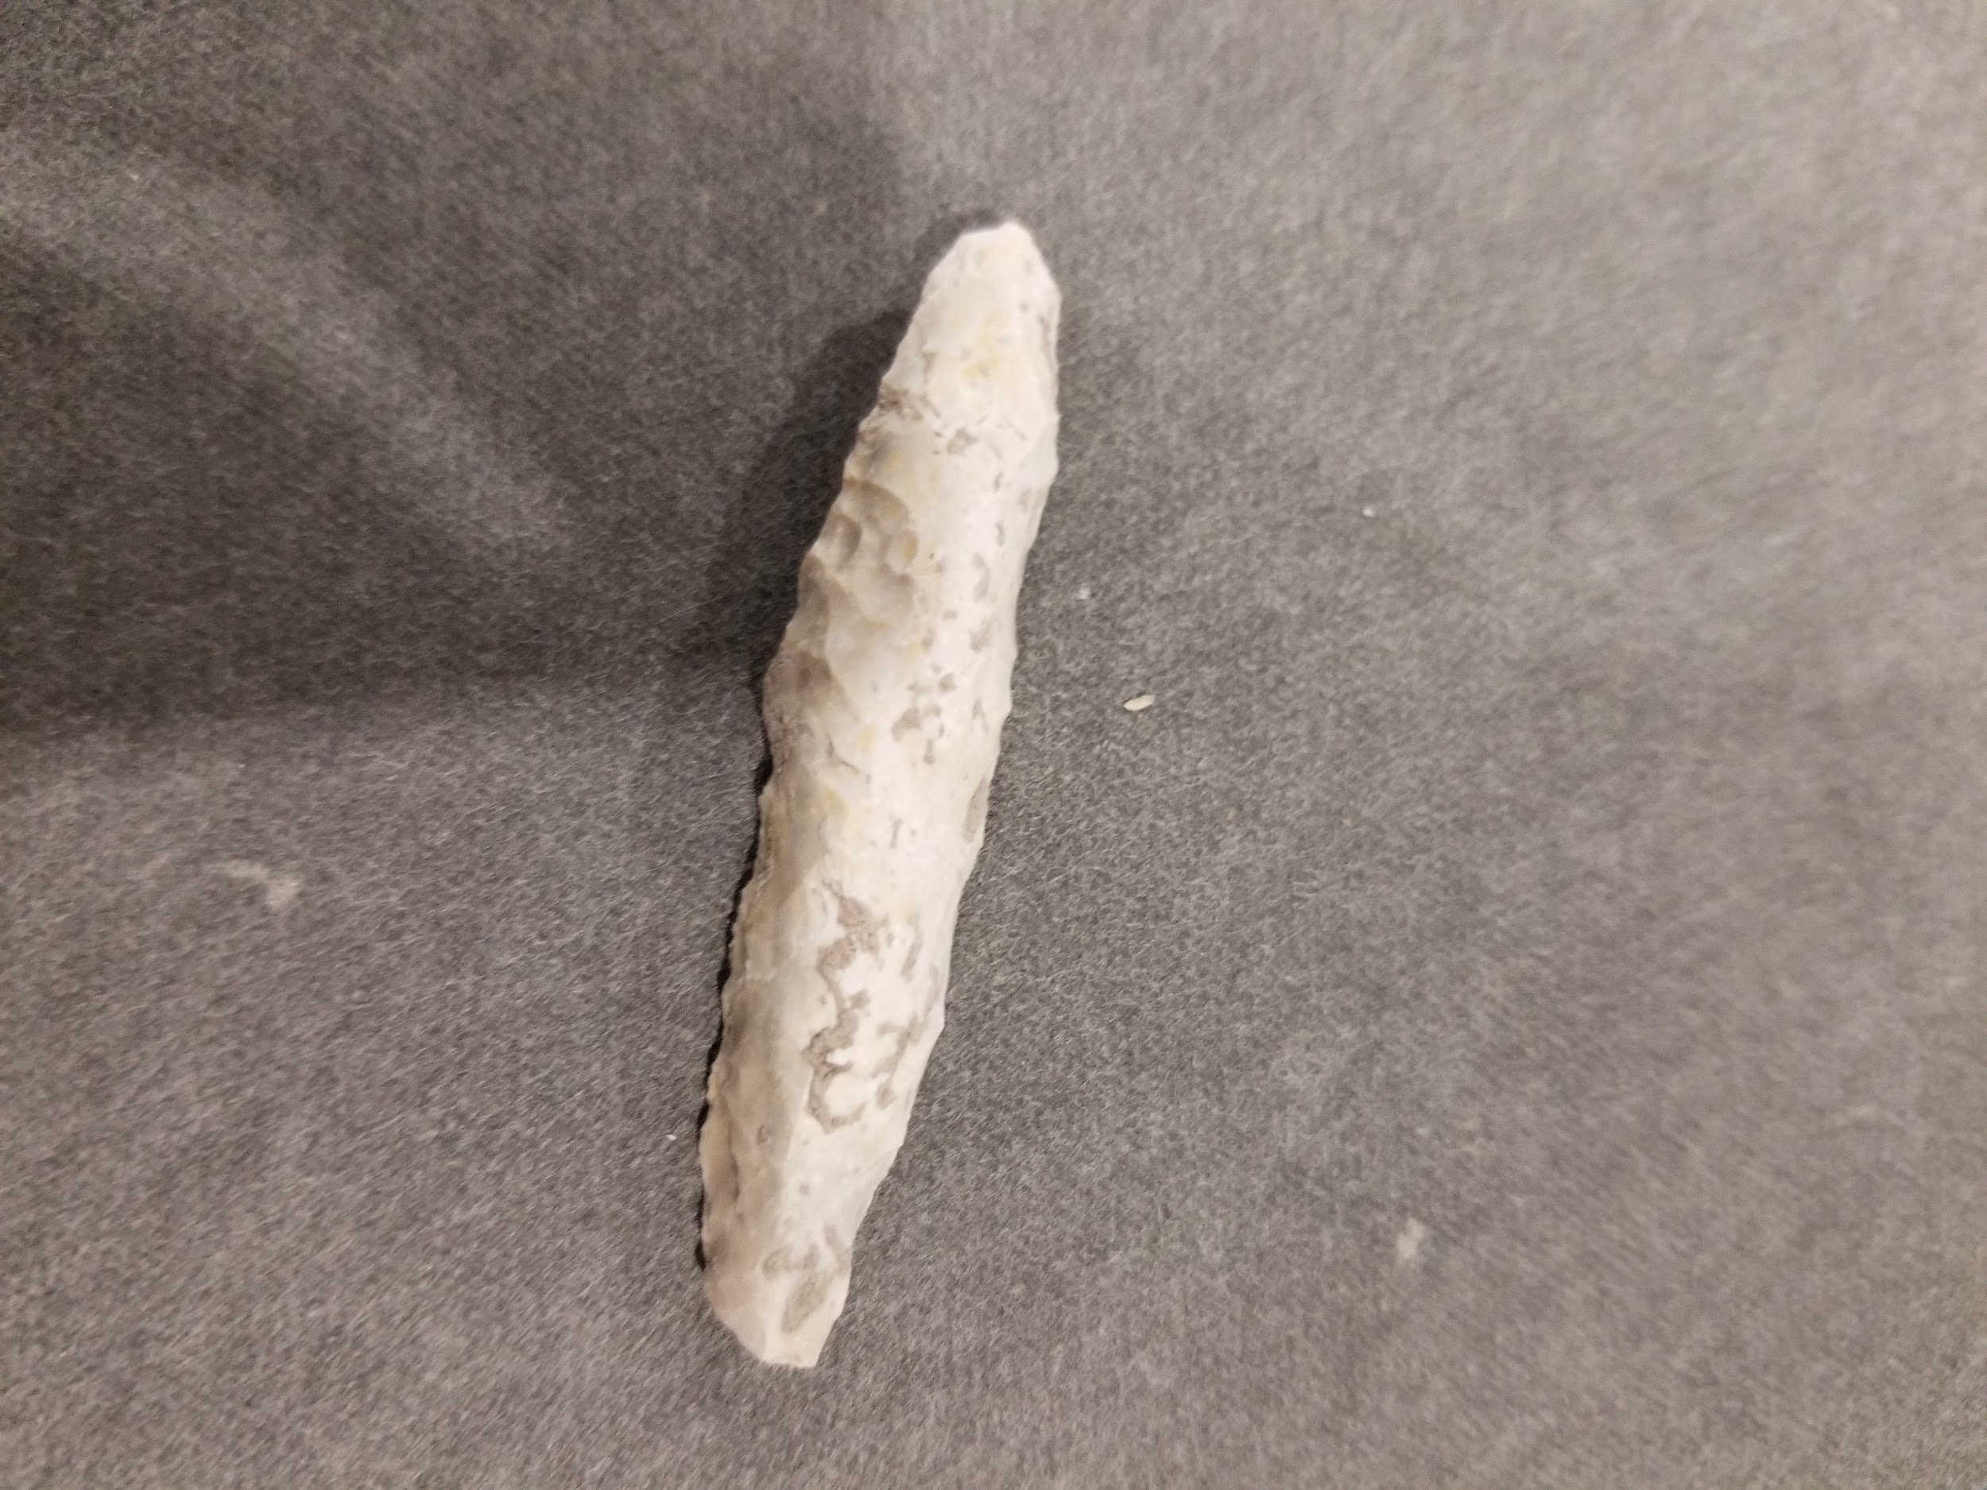
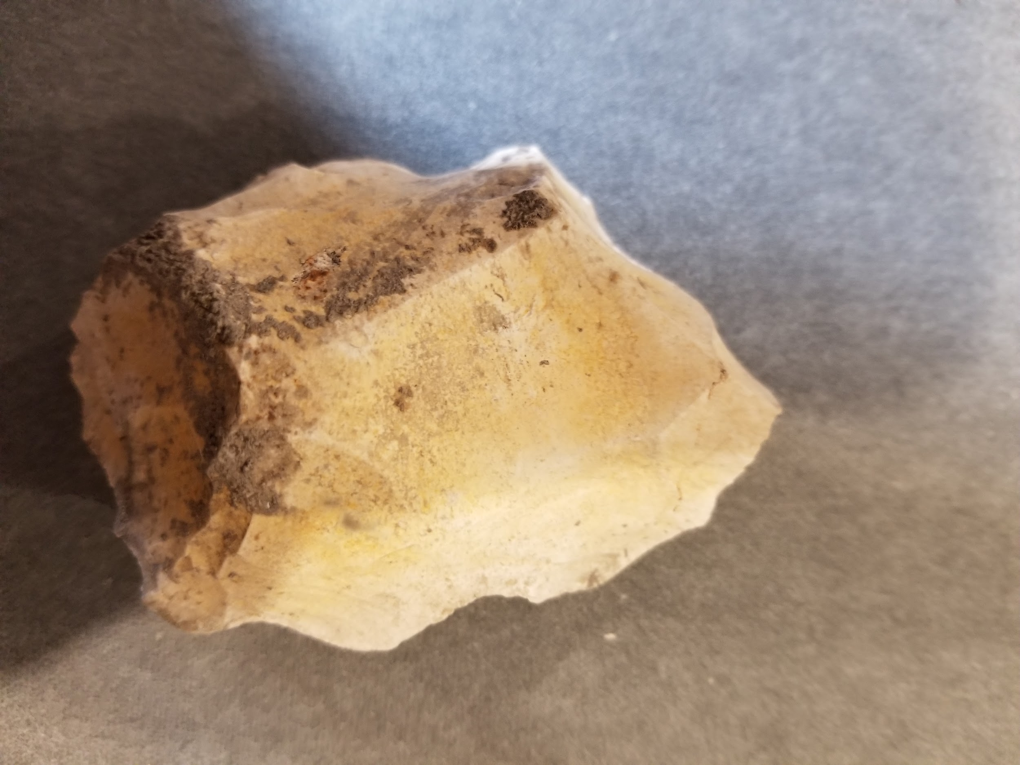
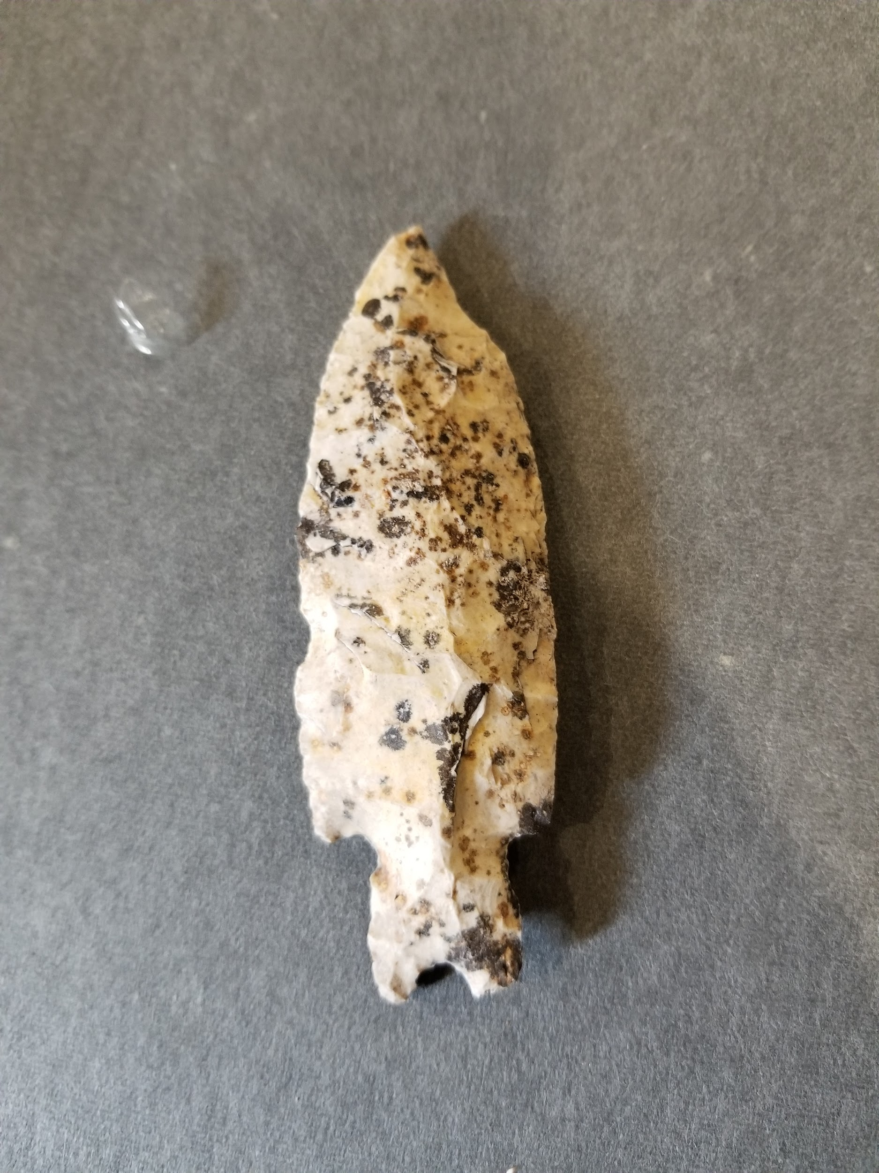
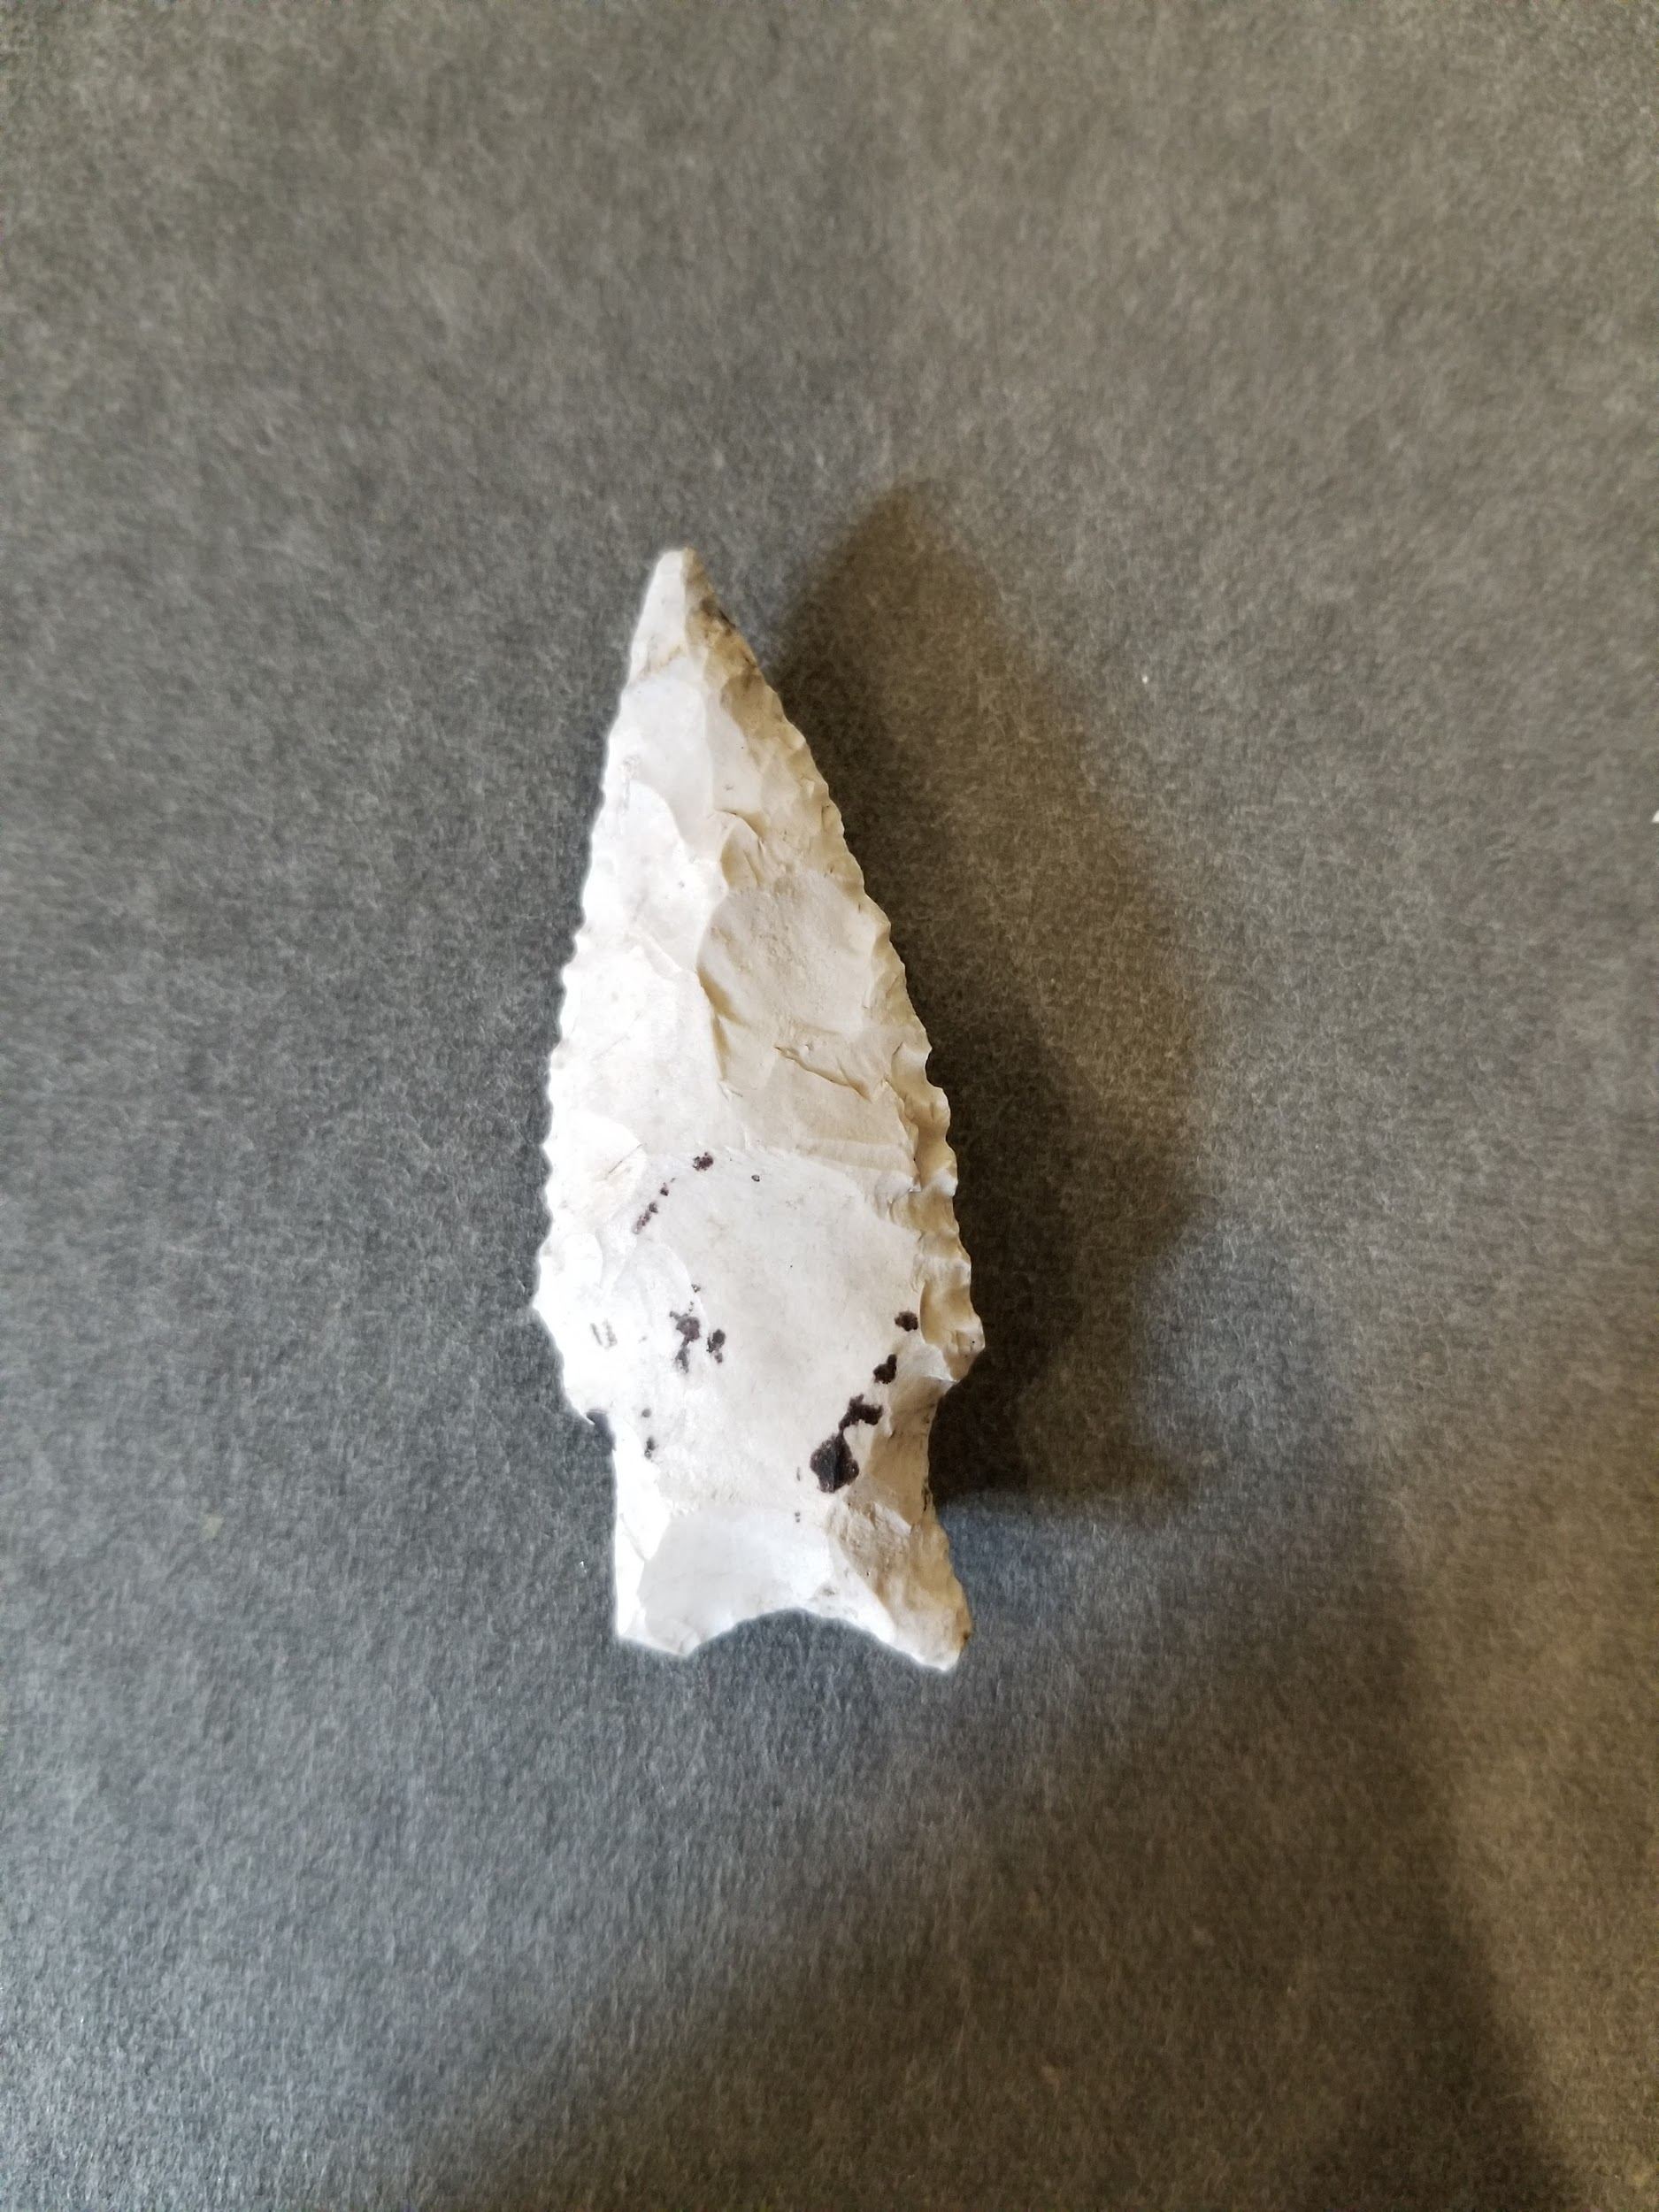
Methods
Data Collection: Sample data observations are the lot bags (1 bag per provenience) from the field site. The contents of the bags were cleaned and inventoried. Each bag represents one observation. 169 bags were recorded (with a few exclusions due to missing proveniences).
Measures: Level numbers were already recorded on the bag and have no units. The stone tools and debitage were hand counted. Stone tools were combined into one category (containing: dart points, arrow points, bifaces/unifaces, etc.)
Analysis Method: After this data was collected, a General Linear Model was run with an interaction using the program Rstudio.
Biface
Awl/Drill
Pedernales Dart Point
Darl Dart Point

Slide 4
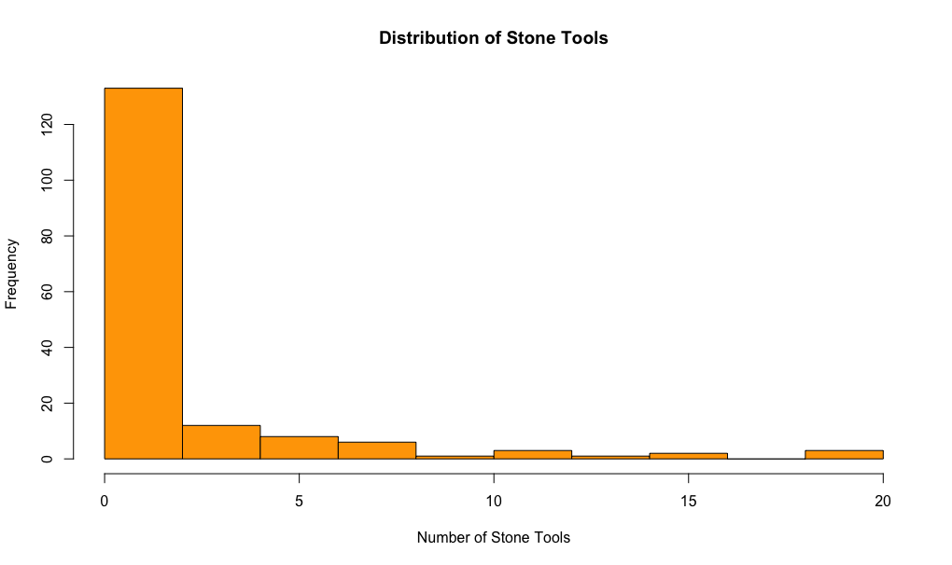
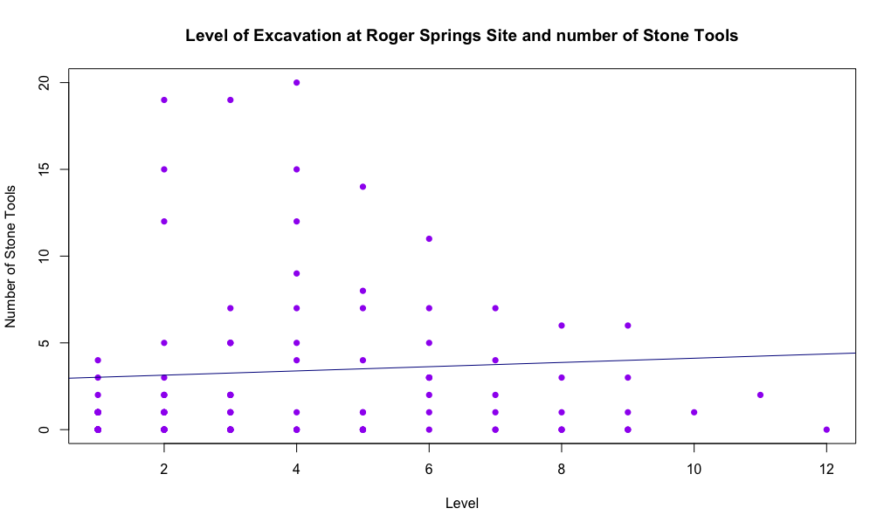
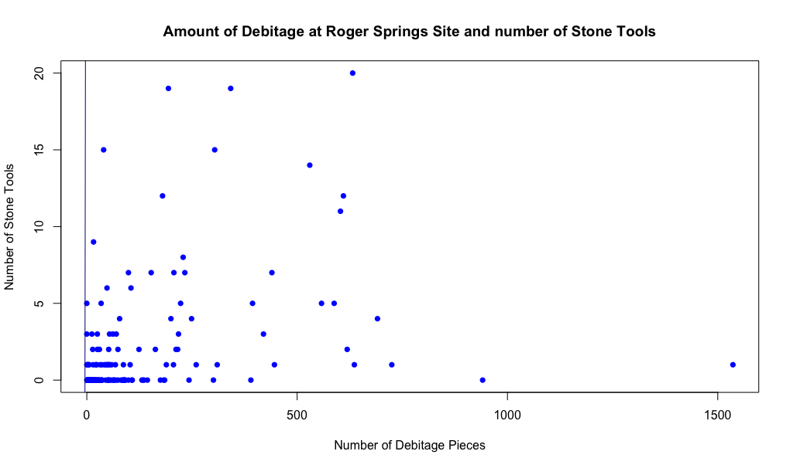
Descriptives
Table 1 – Descriptive Statistics for Number of Stone Tools (n=169)
 | Median | Interquartile Range
Number of Stone Tools | 0 tools | 2 tools
Table 2 – Descriptive Statistics for Excavation Level and Debitage Counts (n=169)
 | Median | Interquartile Range
Excavation Level | Level 2 | 5 levels
Debitage Counts | 48 pieces of debitage | 122 pieces of debitage

Slide 5
Results
Hypotheses
H₀₁: Controlling for debitage count, variation in excavation level does not explain the variation in number of stone tools
H_{A1}: Controlling for debitage count, variation in excavation level does explain the variation in number of stone tools
H₀₂: Controlling for excavation level, variation in debitage count does not explain the variation in number of stone tools
H_{A2}: Controlling for excavation level, variation in debitage count does explain the variation in number of stone tools
H₀₃: There is no interaction between excavation level and debitage count on number of stone tools
H_{A3}: There is an interaction between excavation level and debitage count on number of stone tools
Table 3 - Multiple Regression Results
 | Estimate | Standard Error | T-Statistic | P-Value
Intercept | 1.909 | 0.25 | 7.649 | 1.59e-12*
Level of Excavation | 0.45 | 0.105 | 4.267 | 3.33e-05
Debitage Count | .009 | .001 | 6.802 | 1.81e-10
Interaction Between Level and Debitage Count | .004 | .001 | 4.887 | 2.41e-06
Significance Level: .05 df: 165 Adjusted R-Squared: .2557 Results are rounded to 3 decimal places

Slide 6
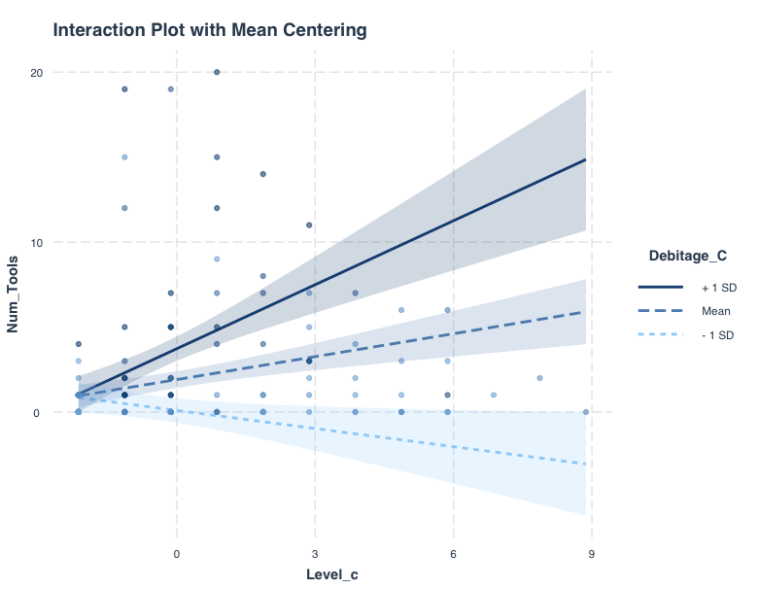
Interaction Plot
Interaction plot including the mean centered excavation level and debitage count

Slide 7
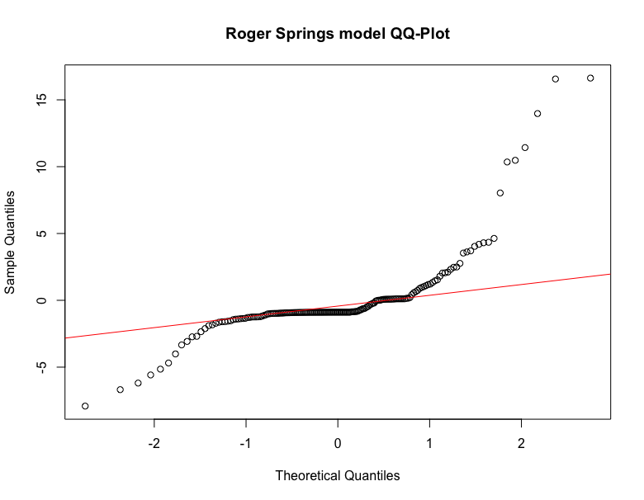
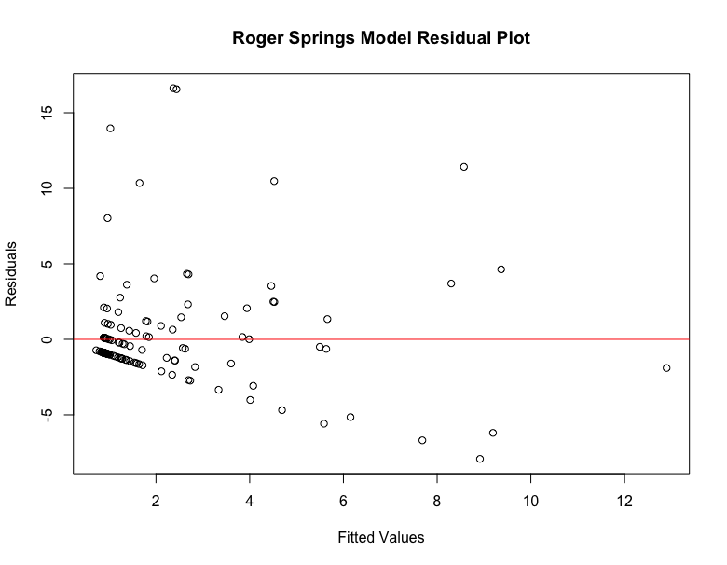
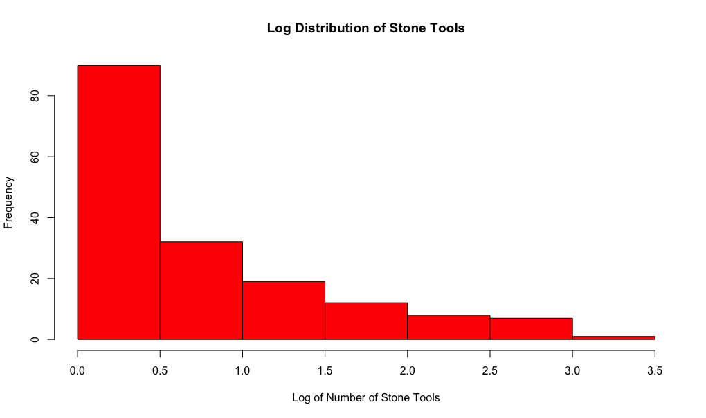
Assumptions
In order to conduct a Multiple Regression, the assumptions of linearity, normality, and equal variance among predictors.
To check Linearity, the scatter plots of level & tools and debitage & tools were visually assessed. These failed as neither graph (shown in descriptives) is remotely linear.
To check Normality, a qq-plot of the entire model was created and compared to the abline of the model. If it had been met, the plot would have been roughly straight against the line. It was not met.
To check Equal Variance amongst my predictors, I created a plot of the residuals. If the assumption had been met, there would have been even scatter. This was not met.
To fix the failed assumptions, a log(x+1) transformation was used, this was not successful.

Slide 8
Discussion
Roger Springs Model Line:
y = 1.909 + .45(level) + .009(debitage count) + .004(level)(debitage count)
After Conducting a GLM for the Roger Springs data, the t-statistics and p-values were calculated for the explanatory variables of Level (t-stat = 4.267, p = 3.33e-05) and Debitage (t-stat = 6.802, p = 1.81e-10) as well as the interaction between them (t-stat = 4.887, p = 2.41e-06). These pe values are all well below .05 which suggests that the data are significant. IT would be safe to reject all 3 hypotheses as this suggests an association (predictability) between stone tool counts, excavation level, and debitage counts with debitage counts being effected by level (more debitage is found on different levels. This should be taken with a grain of salt as R2=.2257 meaning only 23% of the variation in stone tools is explained by the 2 variables.
Limitations
As one unit excavated with an excess of lithic material, new units were likely placed around it. This would cause biased sampling.
My data failed all three assumptions so this could lead to an inaccurate test.
As the site is located on a historic farm property, plow activity around the site could have pushed more debitage and tools to certain levels, this would be a detrimental confounding variable.

Slide 9
Implications and Future Research:
As my results for this were significant, it may be possible to use the model to predict the best levels to excavate for the site. This would also give an idea of the level (each level may represent a time in history depending on relative dating of artifacts found) with the most habitation and whether stone tools are commonly found at places of heavy manufacture (high amounts of debitage). This would overall give a better understanding of site habitation and lithic production. After completing this model it would be a good idea to do a debitage analysis that is widely used in this field and has similar principles to what was conducted here. If I could recreate this project, I would conduct an experiment with the data from the 4 previous excavations of the site rather than focusing on the 2010-2012 material alone and I would look at the debitage as my response variable instead of stone tools as it gives better information about habitation than tools.
References:
“Camp Bowie.” Camp Bowie > What Is a Burned Rock Midden?, www.texasbeyondhistory.net/bowie/middenwhat.html.
Koenig, Charles W. Burned Rock Middens, Settlement Patterns, and Bias in the Lower Pecos Canyonlands of Texas. Texas State University, 2012.
“Prehistory Research Project.” Gault School :: Prehistory Research Project, www.gaultschool.org/about-us/prp.
Weston, Jason, and Raymond Mauldin. “Archaeological Testing of Four Sites on Camp Bowie, Brown County, Texas.” Index of Texas Archaeology: Open Access Gray Literature from the Lone Star State, vol. 2003, no. 1, 2003, doi:10.21112/ita.2003.1.6.

